Slide 1
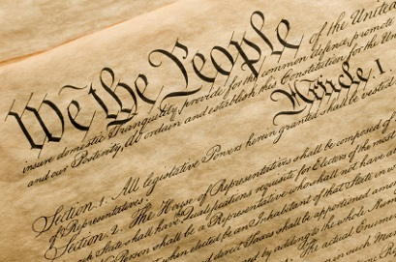
Free Speech?
Notes:
While the Constitution of the United States may guarantee citizens freedom of speech, the Bible does not allow such freedom for citizens of the kingdom of heaven. There are things we are not free to say, but other things that we must say.

Slide 2
God has NOT given us the Freedom to…
Lie (Psalm 116:11; Proverbs 12:22; Ephesians 4:25; Colossians 3:9)
Slander (Prov. 10:18; Psalm 101:5; 140:11)
Use filthy language (1 Tim. 1:9; James 3:8-12; Colossians 3:8; Ephesians 4:29; Prov. 10:31-32)
Gossip (Leviticus 19:16; 1 Tim. 5:13; Proverbs 18:8)
Revile (1 Corinthians 5:11; 6:9-10; 1 Peter 3:8-9)

Slide 3
God HAS given us the Freedom to…
Speak the gospel (Ephesians 6:19-20; Colossians 4:3-4; 2 Timothy 2:9; 2 Corinthians 5:10-11)
Pray (Psalm 54:2; James 1:5; 1 Peter 3:12)
Edify & Encourage (Ephesians 4:29; Job 4:4)
Praise God (Psalm 35:28; 66:17)

Slide 4

Free Speech?
Proverbs 10:19  Matthew 12:36-37

